Slide 1

Al Zaytounah for Home & Office Supplies
Sistema Catalogue – 2025

Slide 2
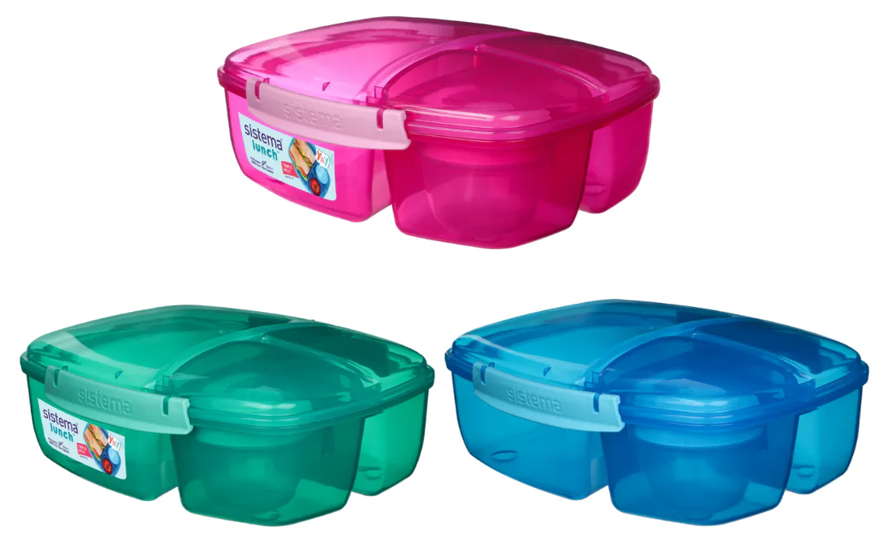
Lunch Boxes
Item Code: SIS/40920
Item Desc: Sistema Triple Split Lunch & Yogurt VAT: 16%
RP: 10.50 JD’s (inc VAT)

Slide 3
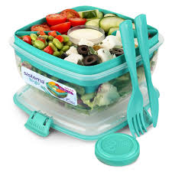
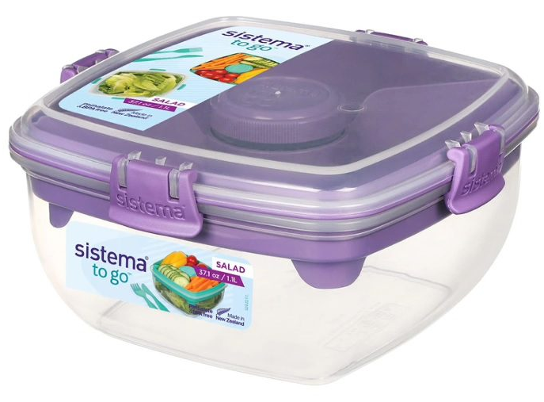
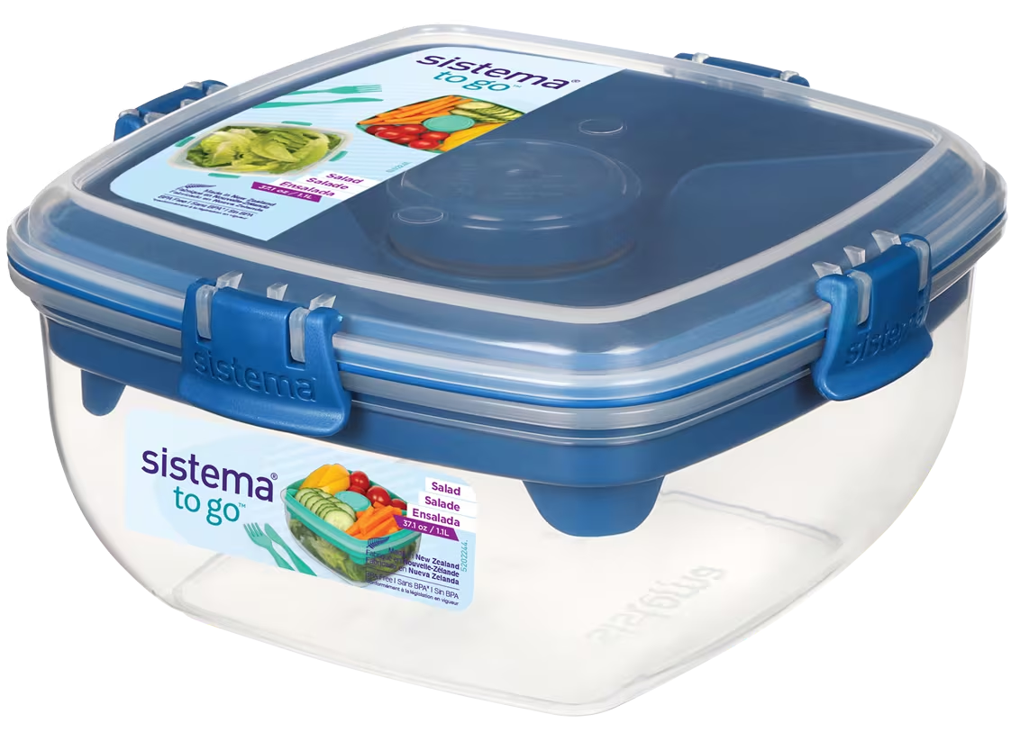
Lunch Boxes
Item Code: SIS/21356
Item Desc: Sistema 1.1L Salad To Go
VAT: 16%
RP: 8.50 JD’s (inc VAT)

Slide 4
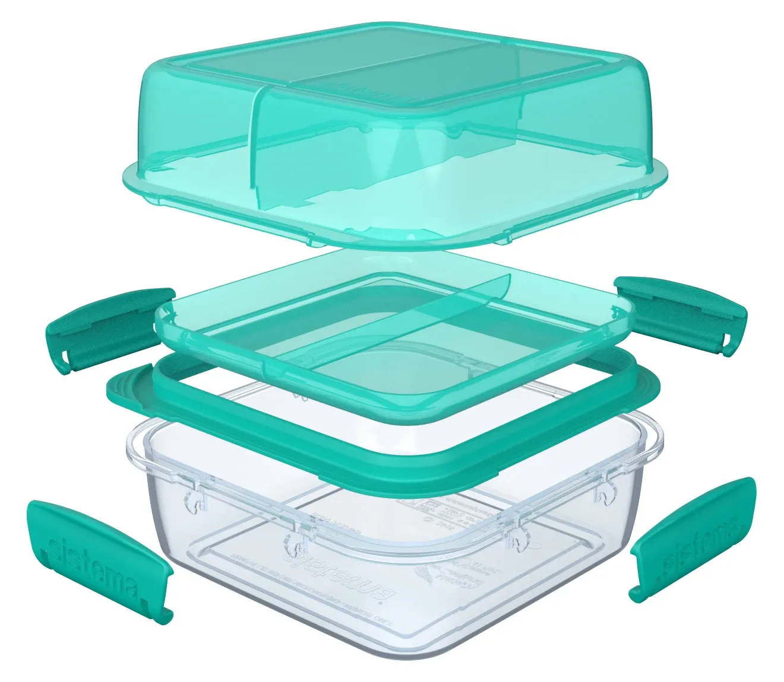
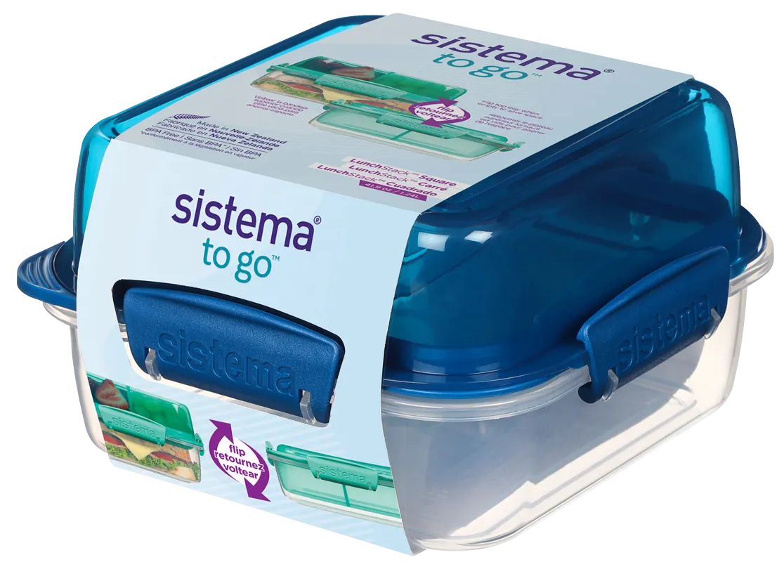
Lunch Boxes
Item Code: SIS/21610
Item Desc: Sistema 1.24L Lunch Stack To Go Square
VAT: 16%
RP: 8.00 JD’s (inc VAT)

Slide 5
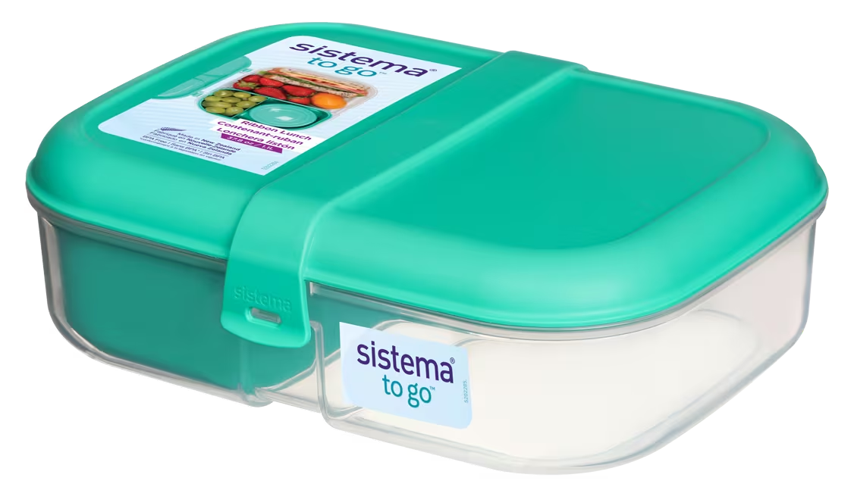
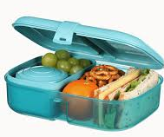
Lunch Boxes
Item Code: SIS/21675
Item Desc: Sistema 1.1L Ribbon Lunch To Go
VAT: 16%
RP: 7.50 JD’s (inc VAT)

Slide 6
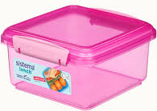
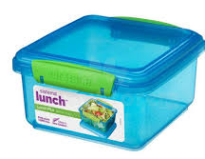
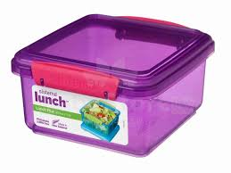
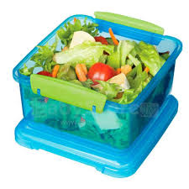
Lunch Boxes
Item Code: SIS/31651
Item Desc: Sistema 1.2L Lunch Plus Lunch
VAT: 16%
RP: 4.50 JD’s (inc VAT)

Slide 7
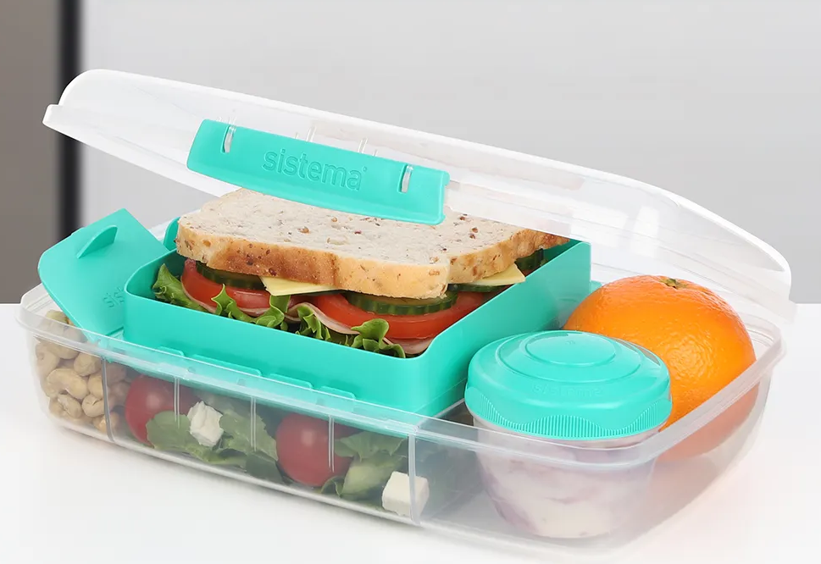
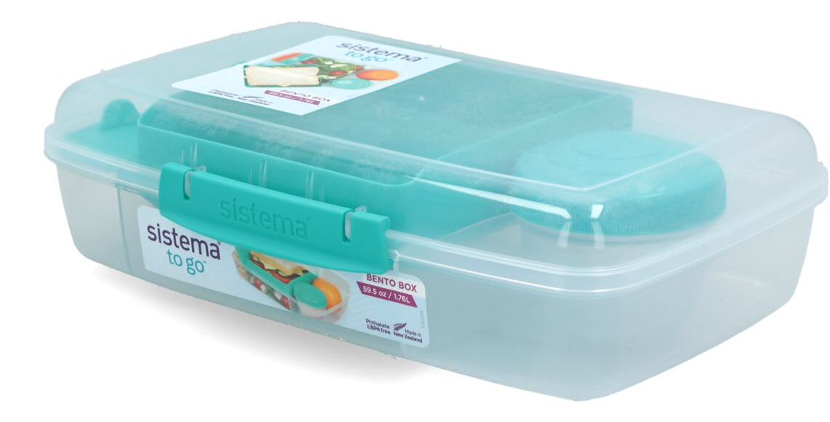
Lunch Boxes
Item Code: SIS/21671
Item Desc: Sistema 1.76L Bento Box To Go
VAT: 16%
RP: 12.00 JD’s (inc VAT)

Slide 8
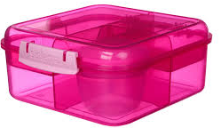
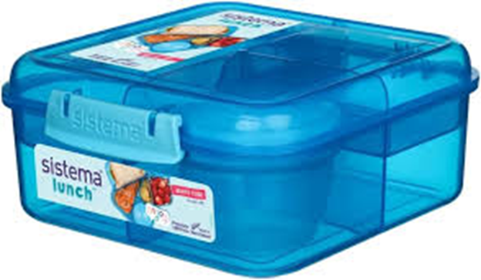
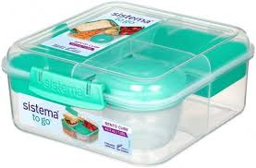
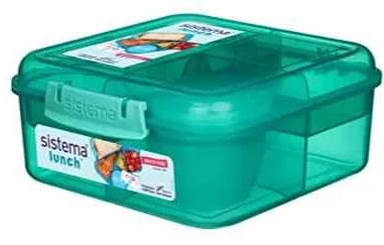
Lunch Boxes
Item Code: SIS/21685
Item Desc: Sistema 1.25L Bento Cube To Go
VAT: 16%
RP: 10.00 JD’s (inc VAT)
Item Code: SIS/41685
Item Desc: Sistema 1.25L Bento Cube Lunch
VAT: 16%
RP: 10.00 JD’s (inc VAT)

Slide 9
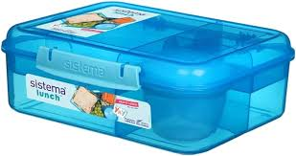
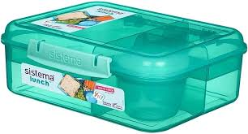
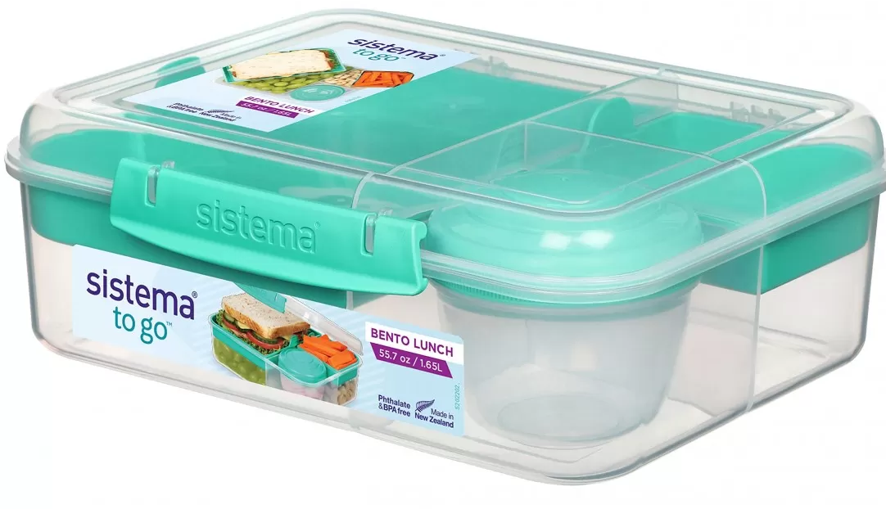
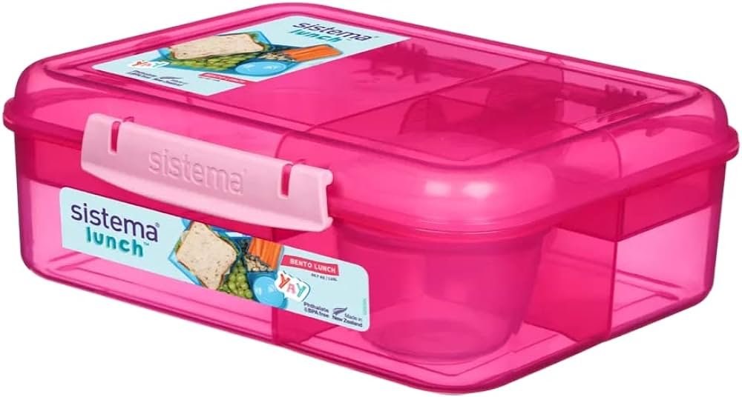
Lunch Boxes
Item Code: SIS/21690
Item Desc: Sistema 1.65L Bento Lunch To Go
VAT: 16%
RP: 11.00 JD’s (inc VAT)
Item Code: SIS/41690
Item Desc: Sistema 1.65L Bento Lunch
VAT: 16%
RP: 11.00 JD’s (inc VAT)

Slide 10
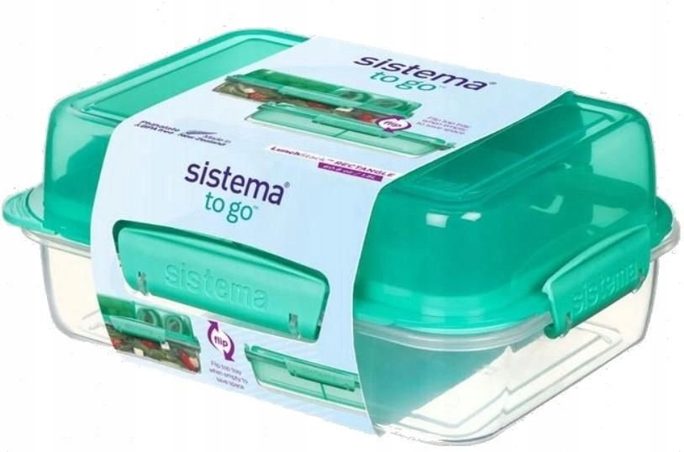
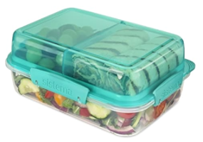
Lunch Boxes
Item Code: SIS/21710
Item Desc: Sistema 1.8L Lunch Stack To Go Rectangle
VAT: 16%
RP: 9.00 JD’s (inc VAT)

Slide 11
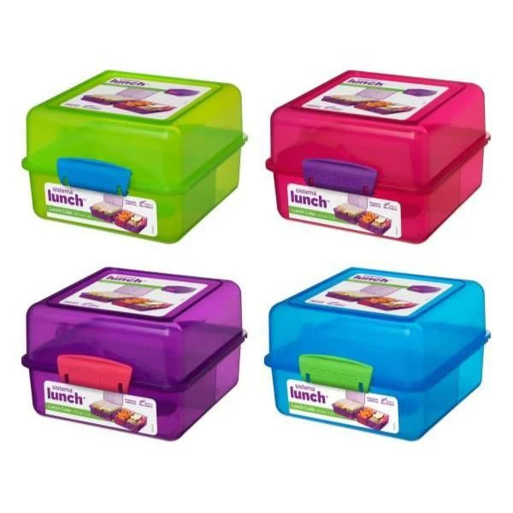
Lunch Boxes
Item Code: SIS/31735
Item Desc: Sistema 1.4L Lunch Cube Coloured
VAT: 16%
RP: 6.00 JD’s (inc VAT)

Slide 12
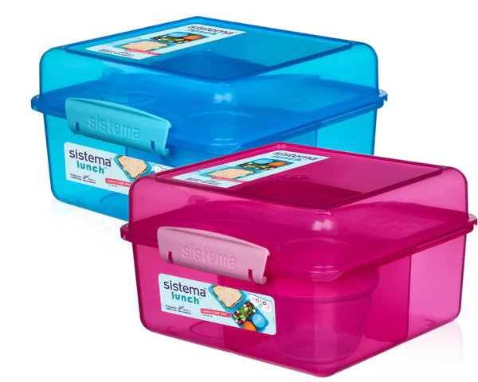
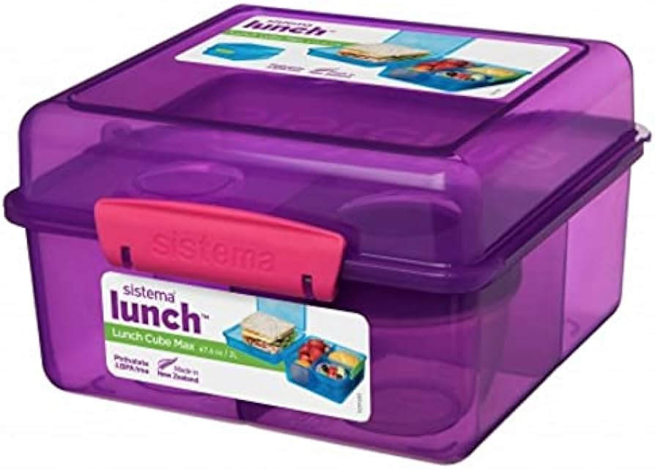
Lunch Boxes
Item Code: SIS/41745
Item Desc: Sistema Lunch Cube Max With Yogurt
VAT: 16%
RP: 9.00 JD’s (inc VAT)

Slide 13
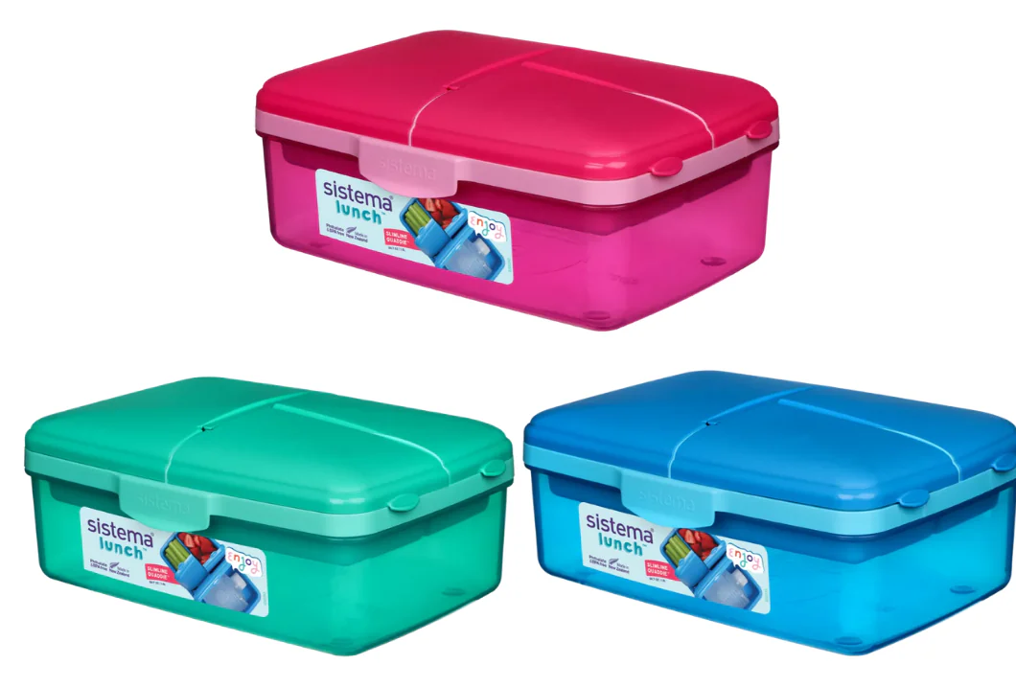
Lunch Boxes
Item Code: SIS/3965
Item Desc: Sistema 1.5L Slimline Quaddie
VAT: 16%
RP: 10.50 JD’s (inc VAT)

Slide 14
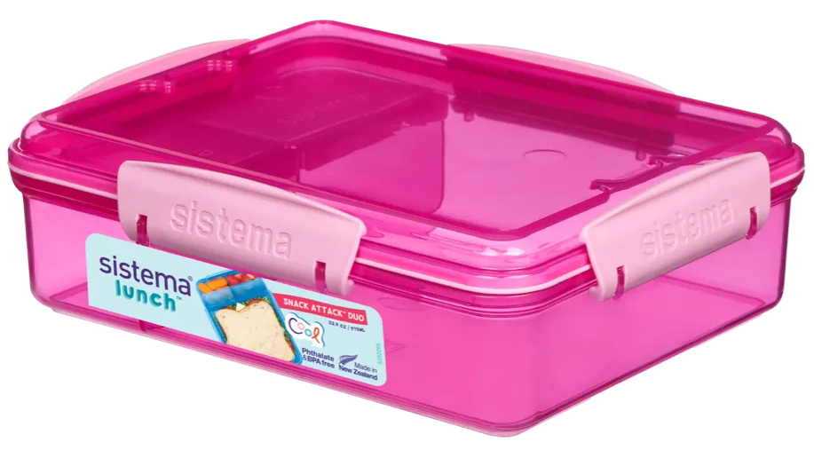
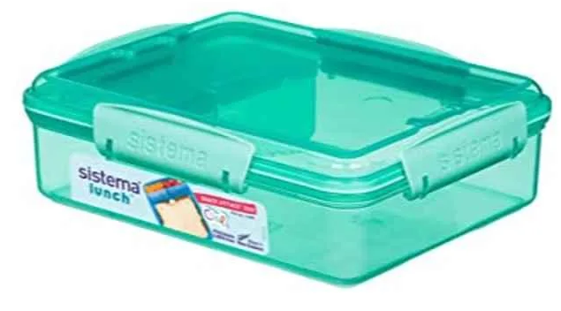
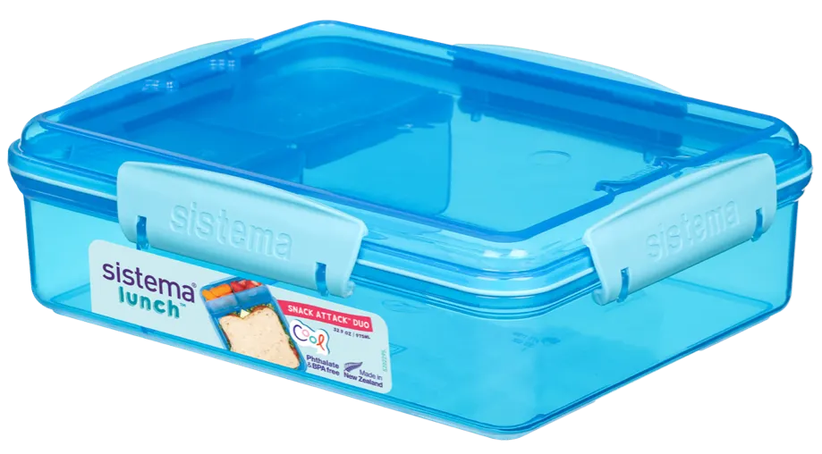
Lunch Boxes
Item Code: SIS/41482
Item Desc: Sistema 975ml Snack Attack Duo
VAT: 16%
RP: 8.00 JD’s (inc VAT)

Slide 15
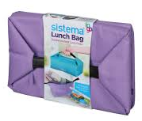
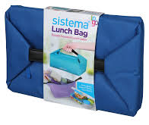
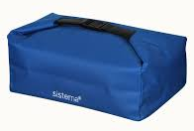
Lunch Bags
Item Code: SIS/4585
Item Desc: Sistema Bento Lunch Bag To Go
VAT: 16%
RP: 12.50 JD’s (inc VAT)

Slide 16
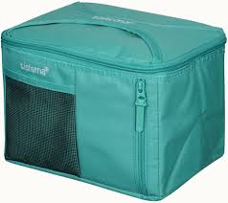
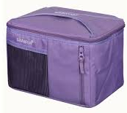
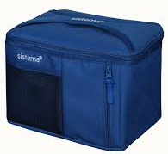
Lunch Bags
Item Code: SIS/4591
Item Desc: Sistema Mega Fold Up Cooler Bag
VAT: 16%
RP: 16.50 JD’s (inc VAT)

Slide 17
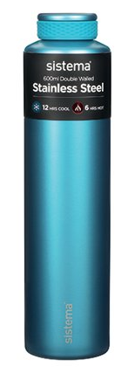
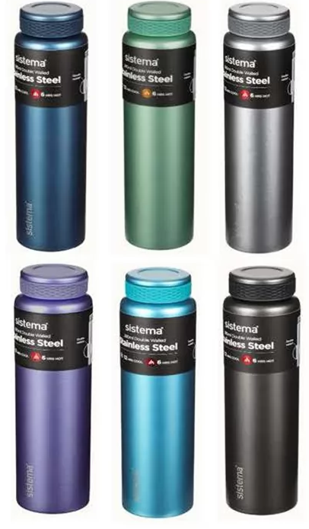
Water Bottles
Item Code: SIS/520
Item Desc: Sistema 600ml Chic Stainless Steel Bottle
VAT: 16%
RP: 26.00 JD’s (inc VAT)

Slide 18
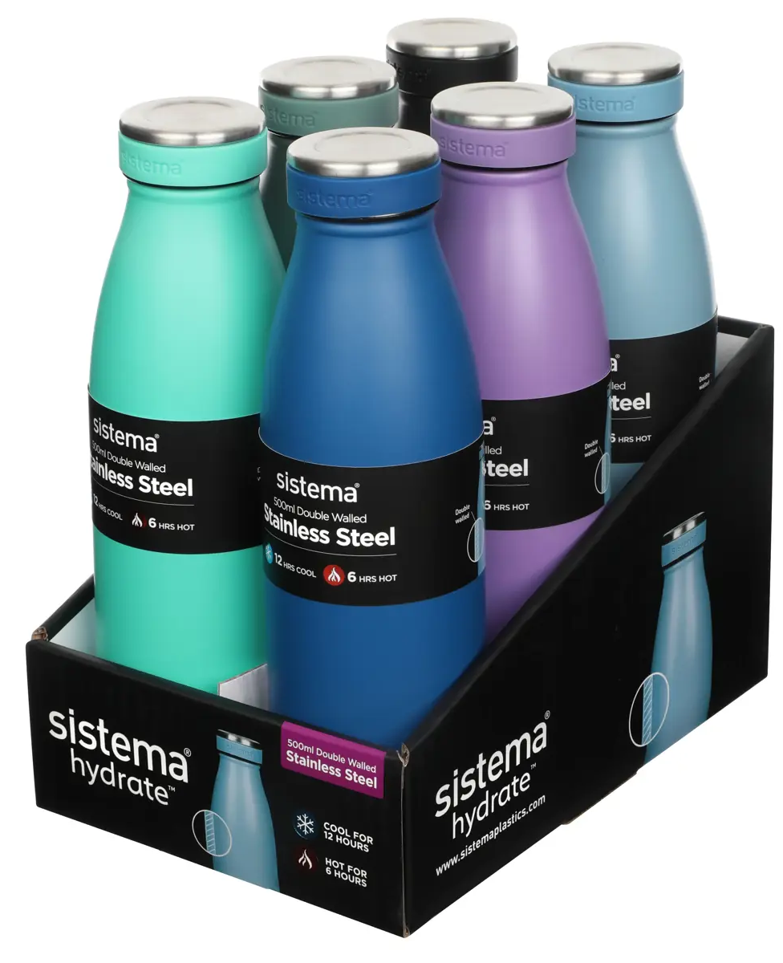
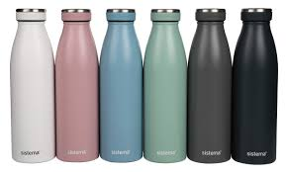
Water Bottles
Item Code: SIS/550
Item Desc: Sistema 500ml Stainless Steel Bottle
VAT: 16%
RP: 19.00 JD’s (inc VAT)

Slide 19
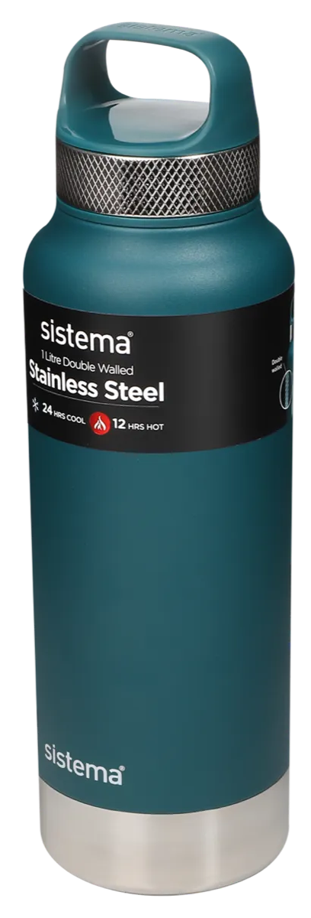
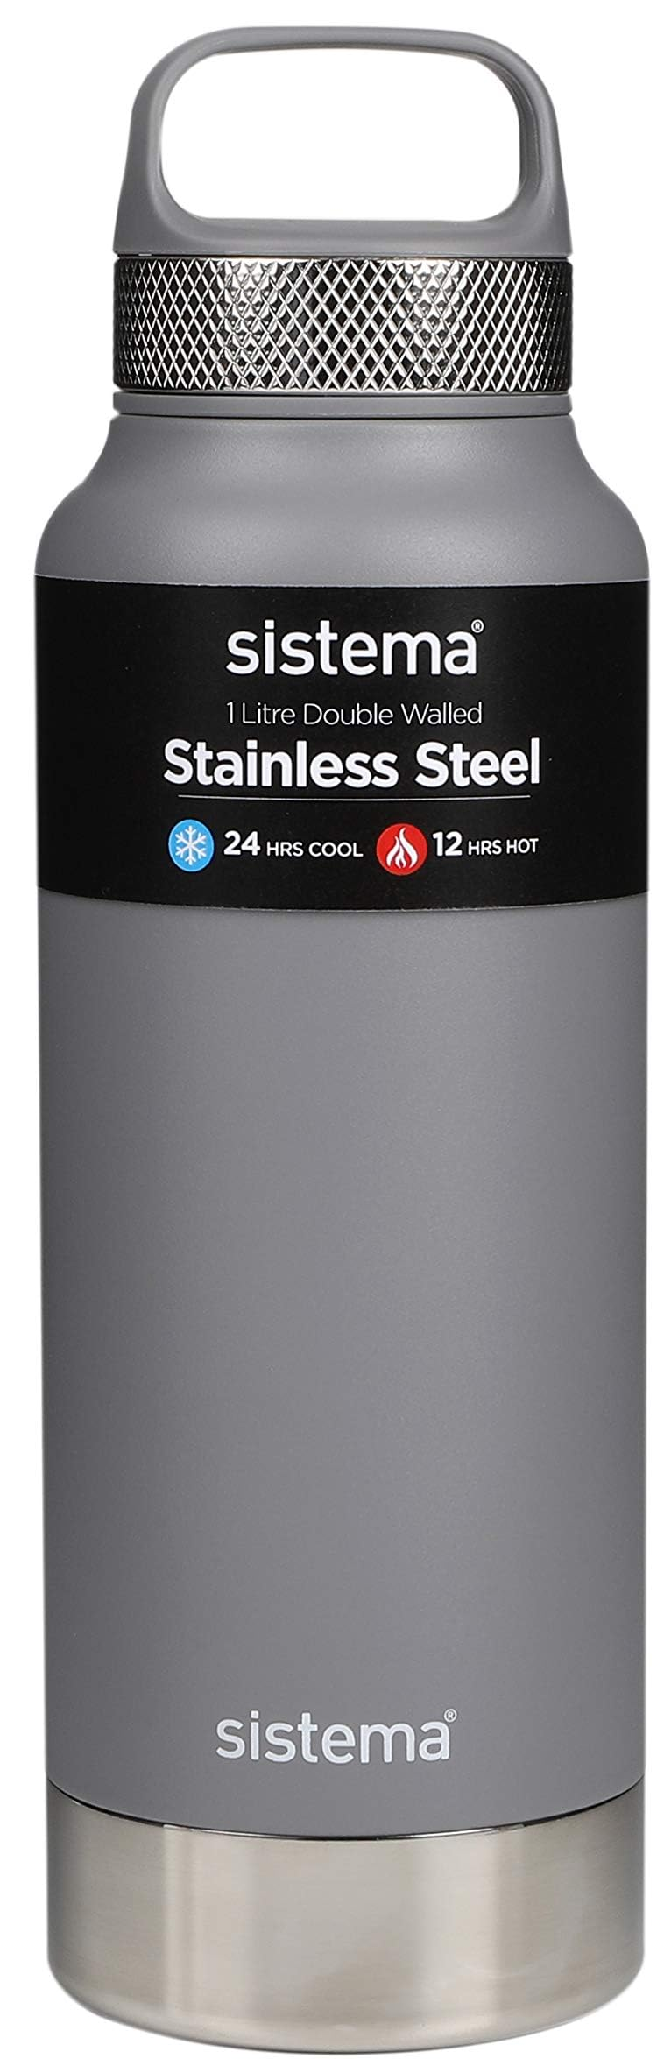
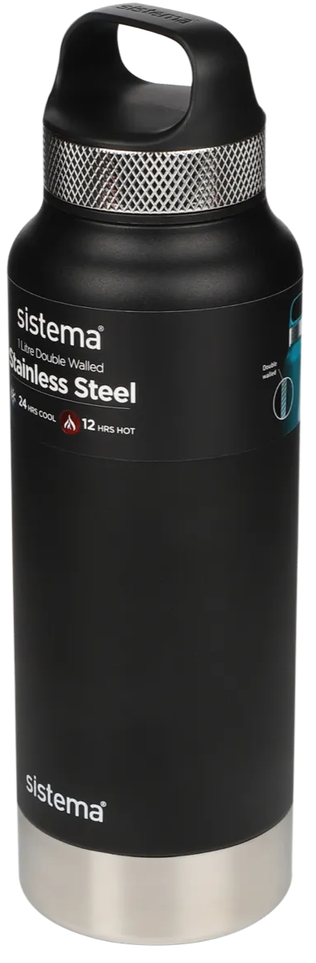
Water Bottles
Item Code: SIS/585
Item Desc: Sistema 1L Stainless Steel Bottle
VAT: 16%
RP: 37.00 JD’s (inc VAT)

Slide 20
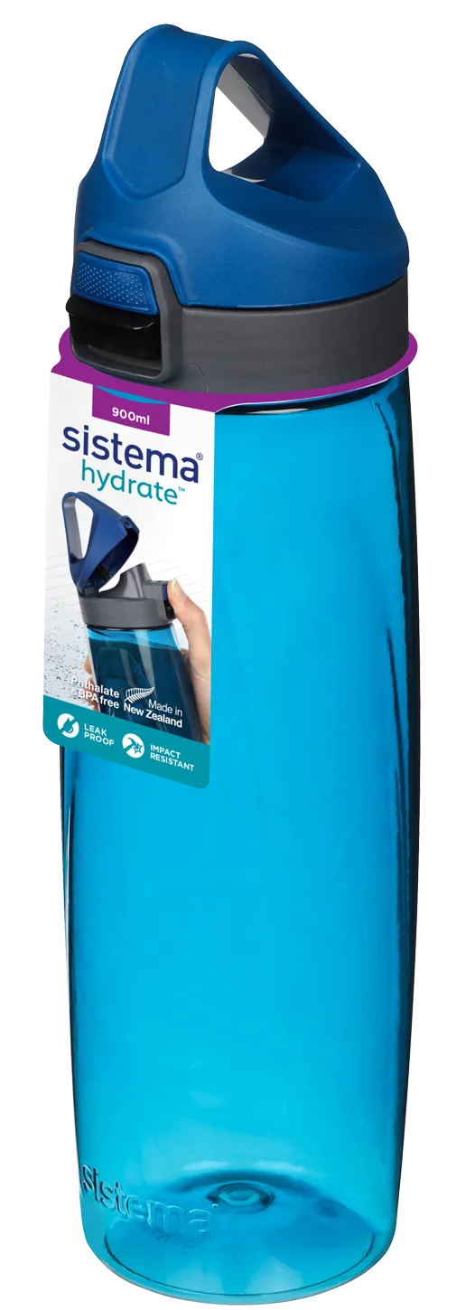
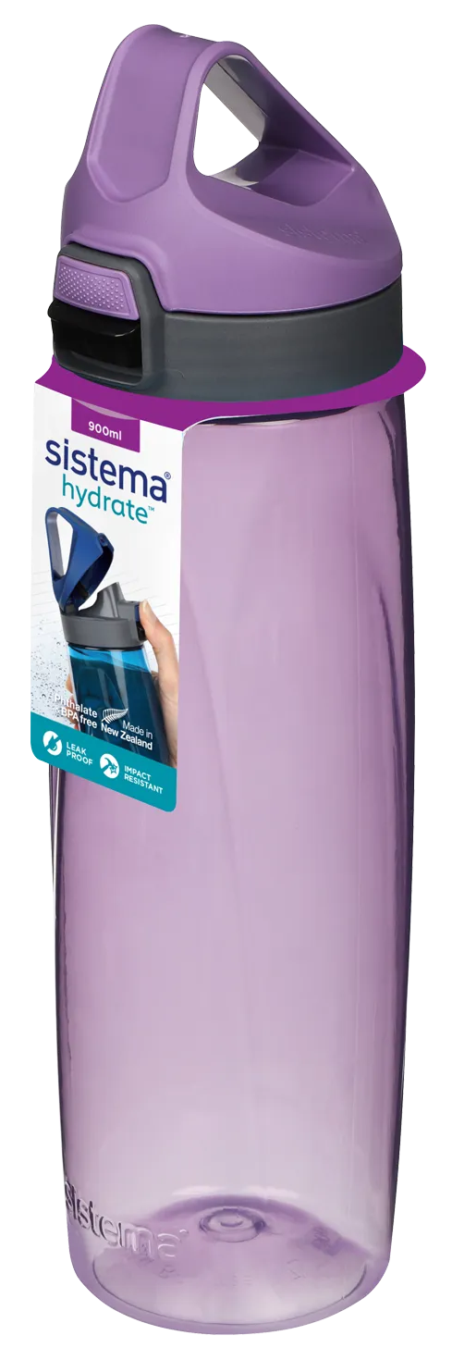
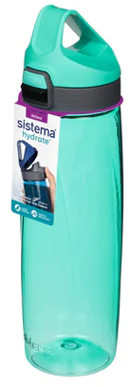
Water Bottles
Item Code: SIS/680
Item Desc: Sistema 900ml Tritan Adventum Bottle
VAT: 16%
RP: 13.00 JD’s (inc VAT)

Slide 21
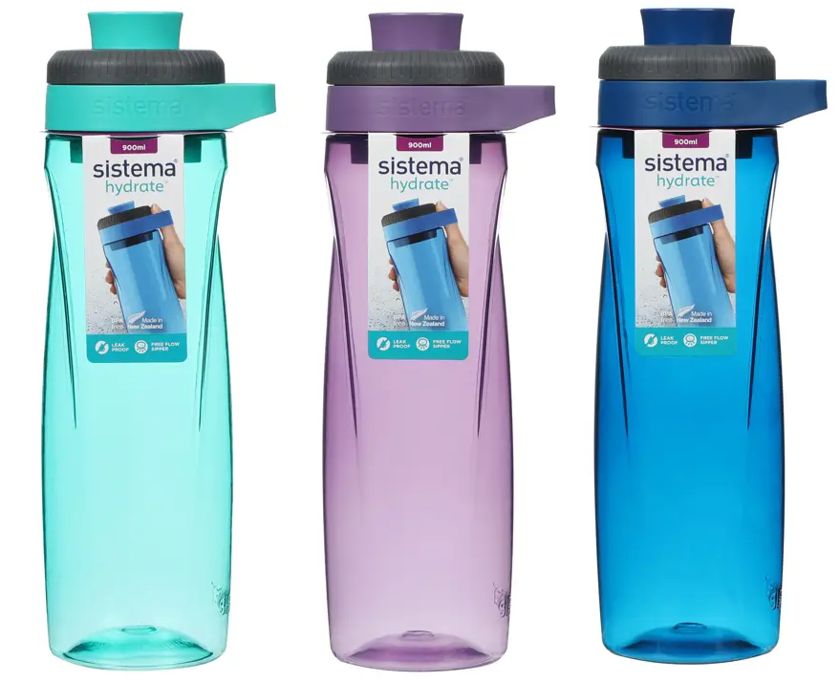

Water Bottles
Item Code: SIS/685
Item Desc: 900 ml Twist & Chug
VAT: 16%
RP: 9.50 JD’s (inc VAT)

